Slide 1

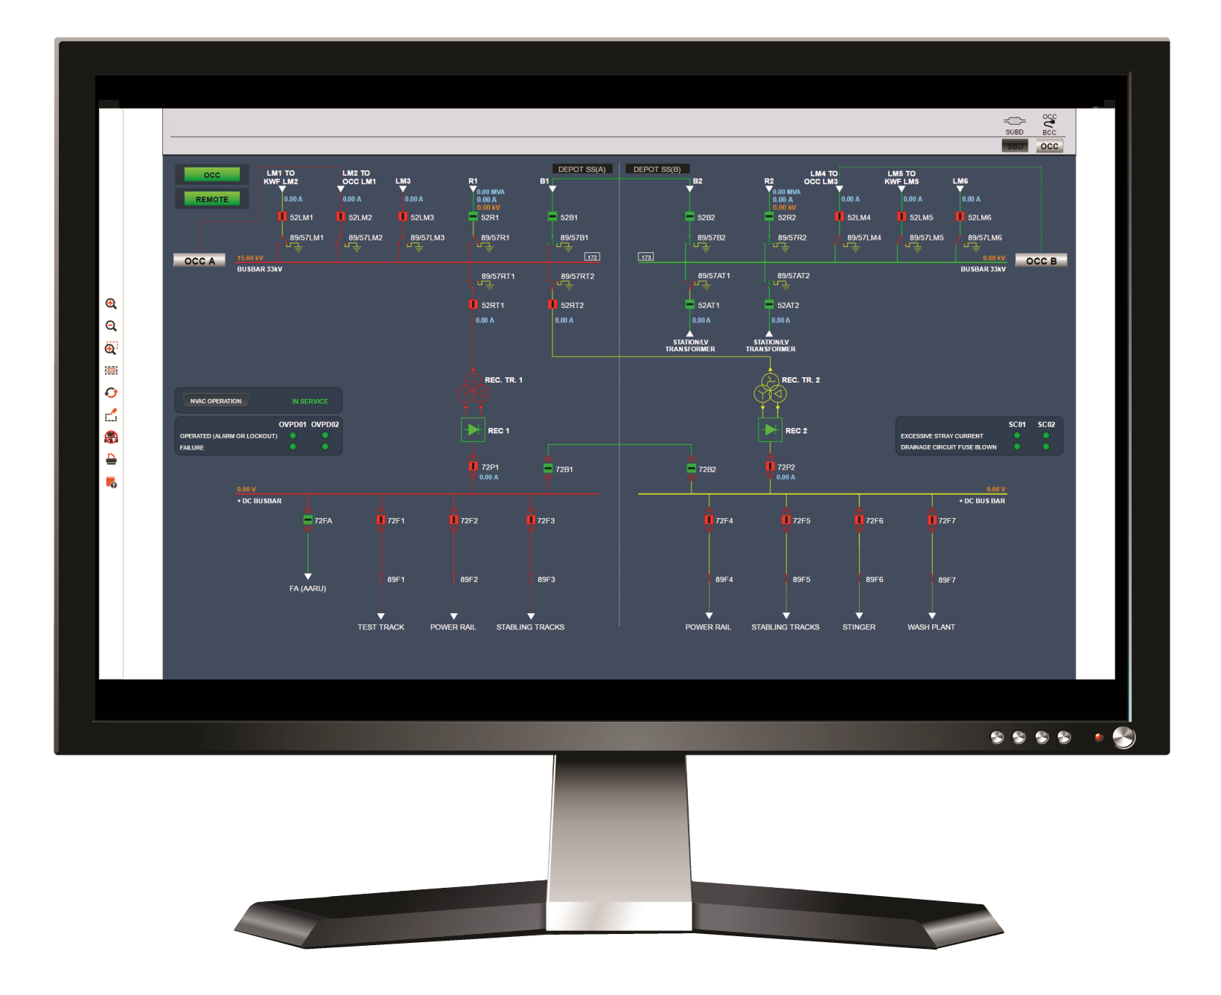
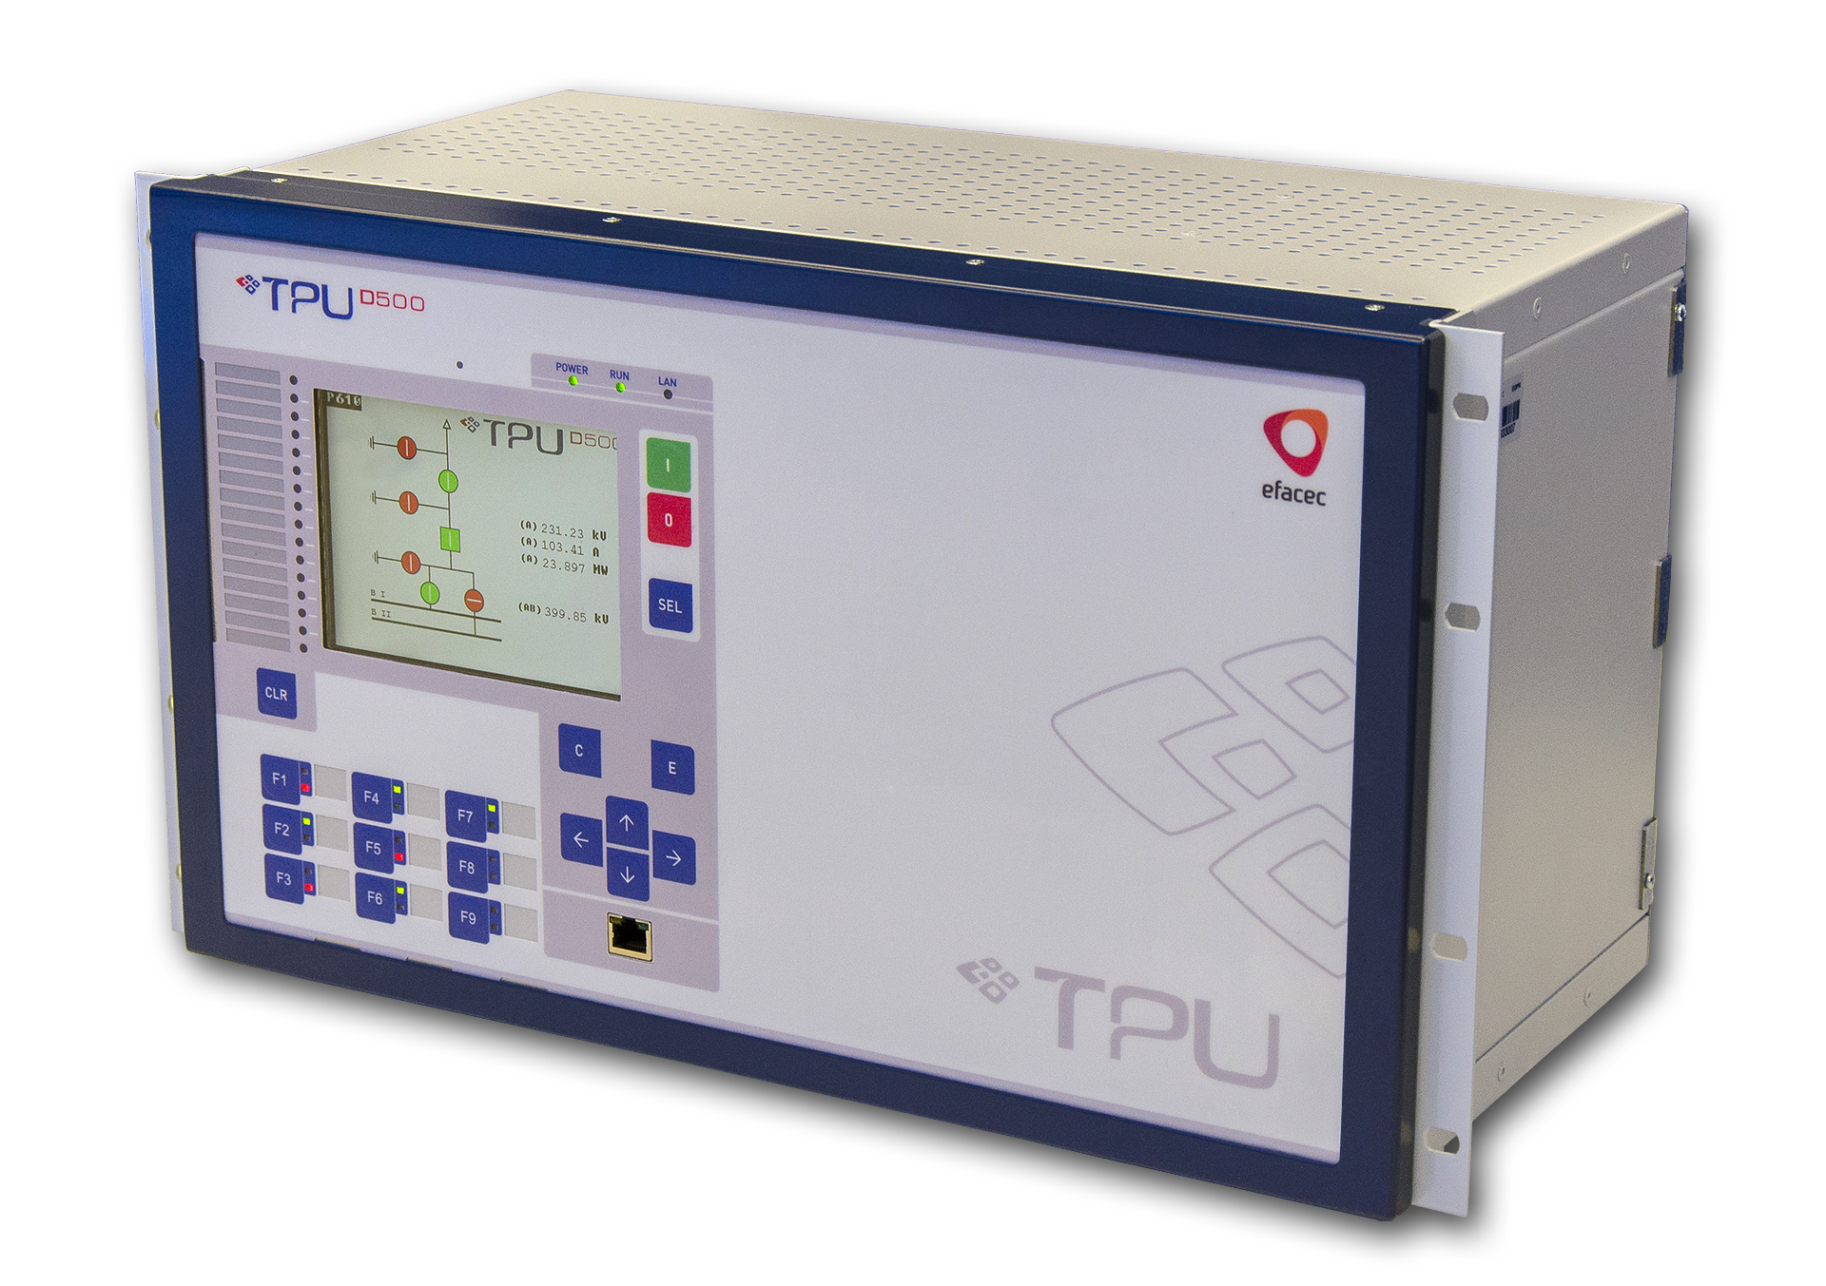
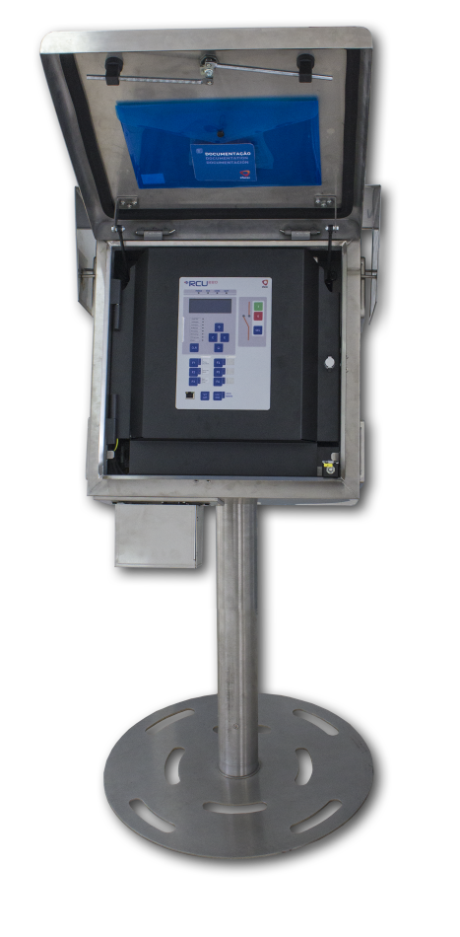
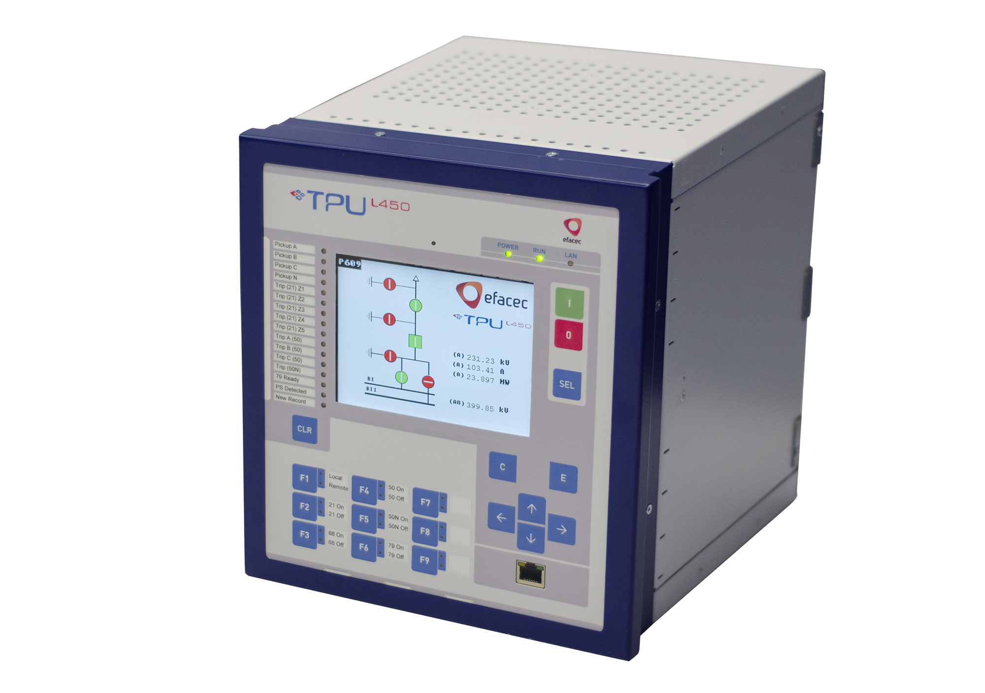
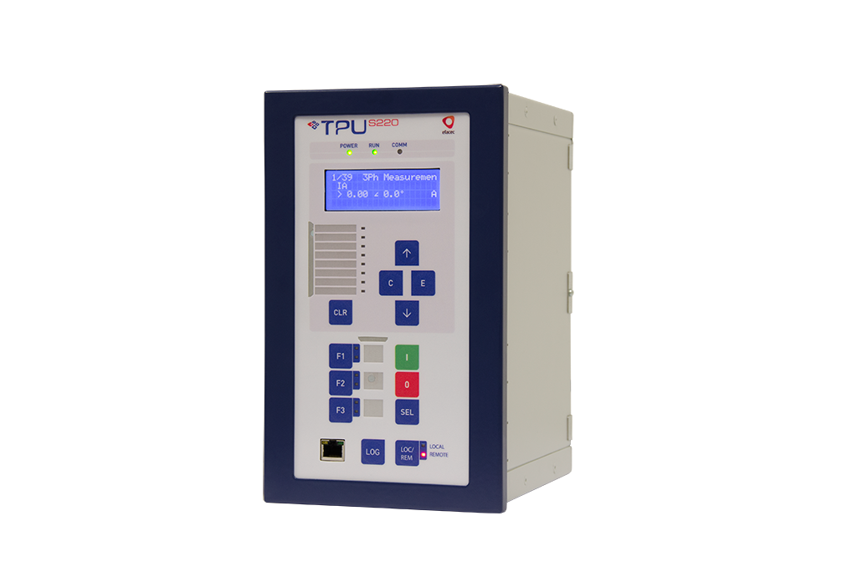
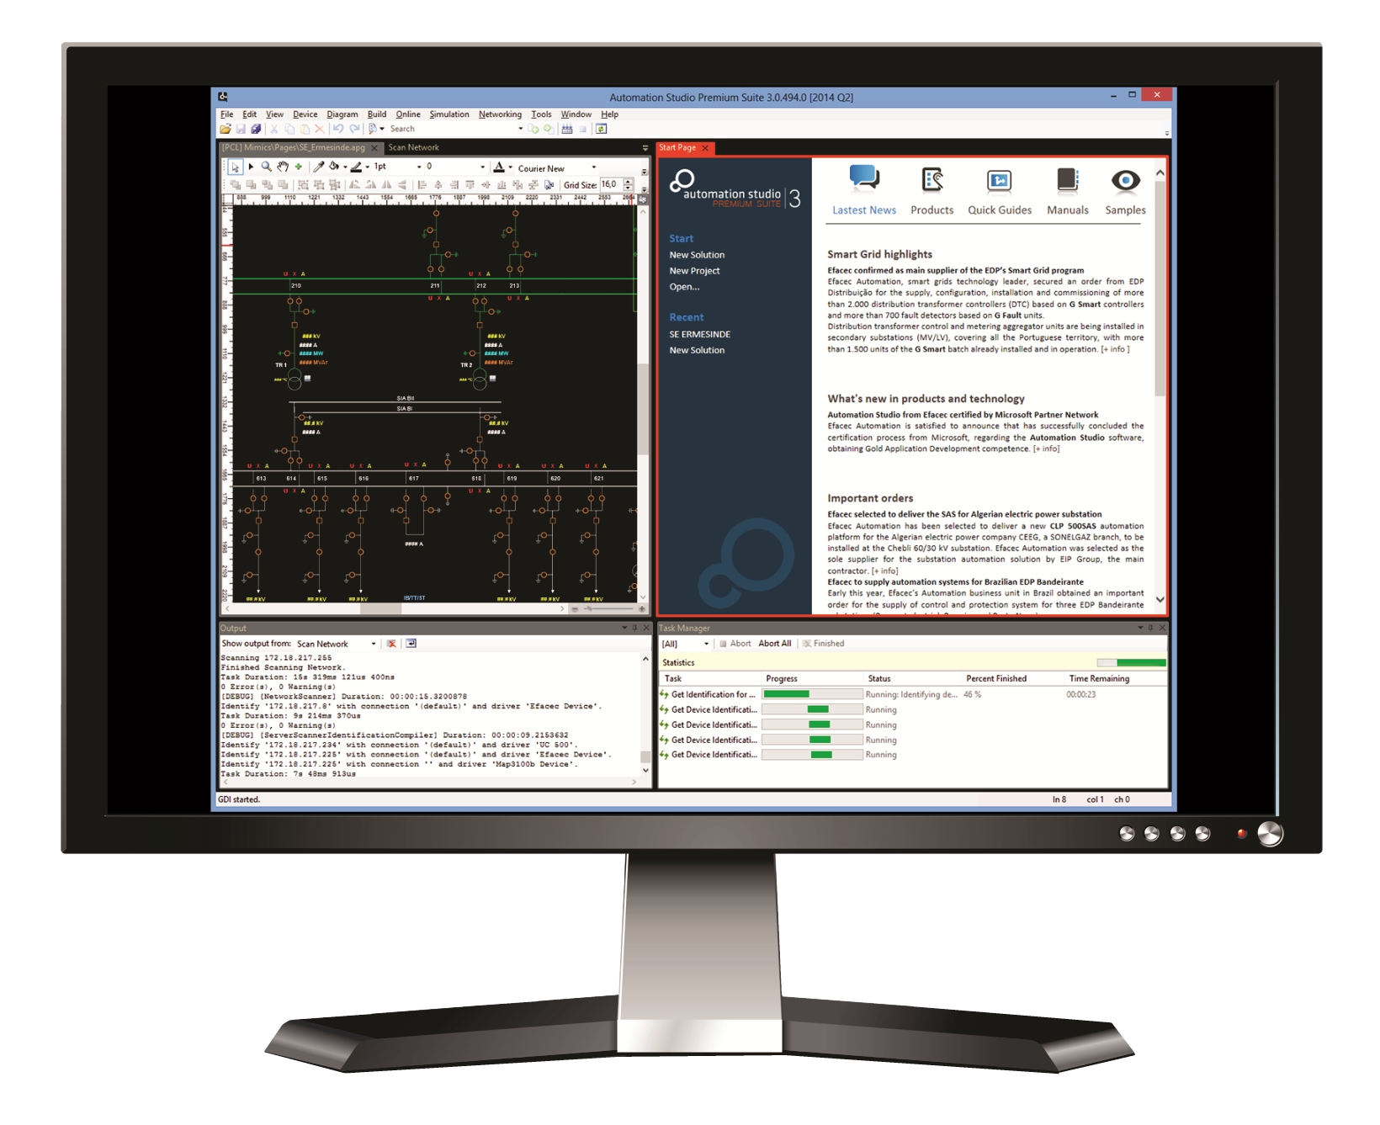
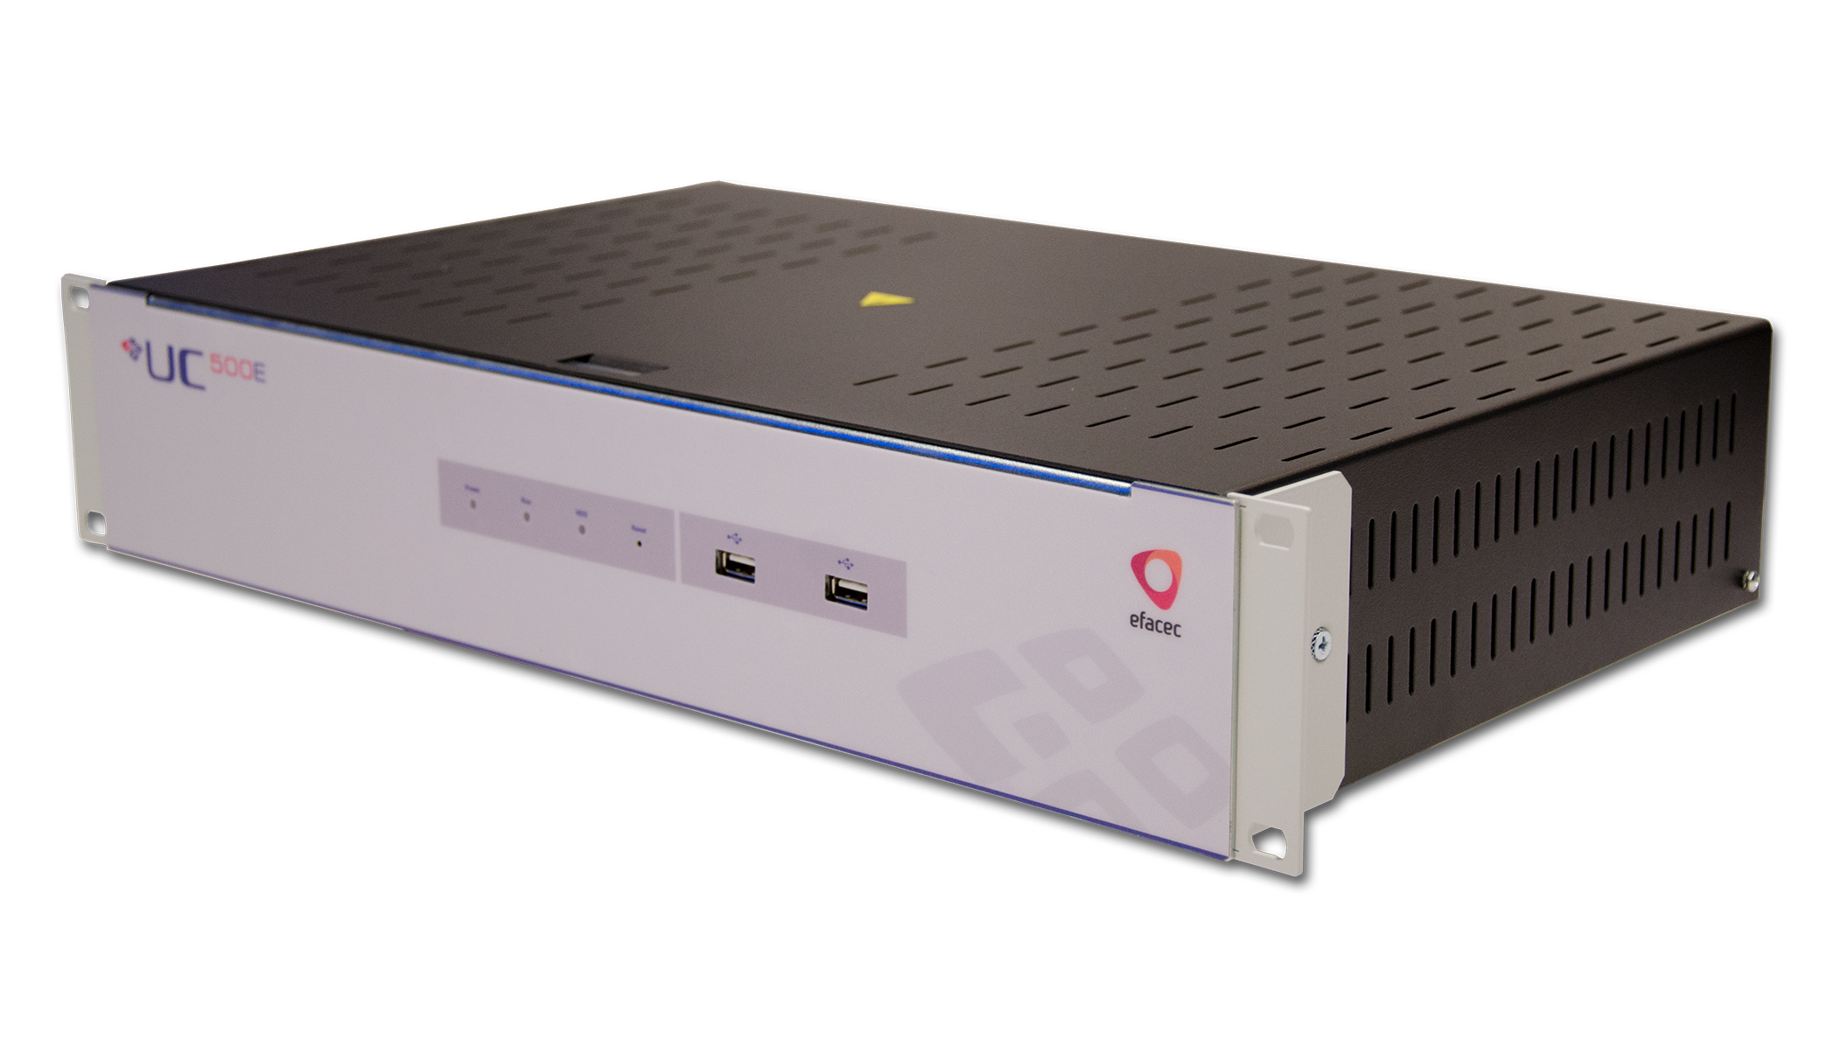
IEC 61850 At the Core!
Products for Digital Grid Automation
Proven interoperability worldwide
Broad portfolio and references
IEC 61850 Edition 1 and 2
System Management Software
Support for Process Bus
System Engineering Tool
HSR, PRP and RSTP Redundancy
IEC 61131-3
Web-based HMI
Station and HMI | Transmission | Sub-transmission | Distribution | Feeder | System Engineering
  www.efacec.com/automation

