Slide 1
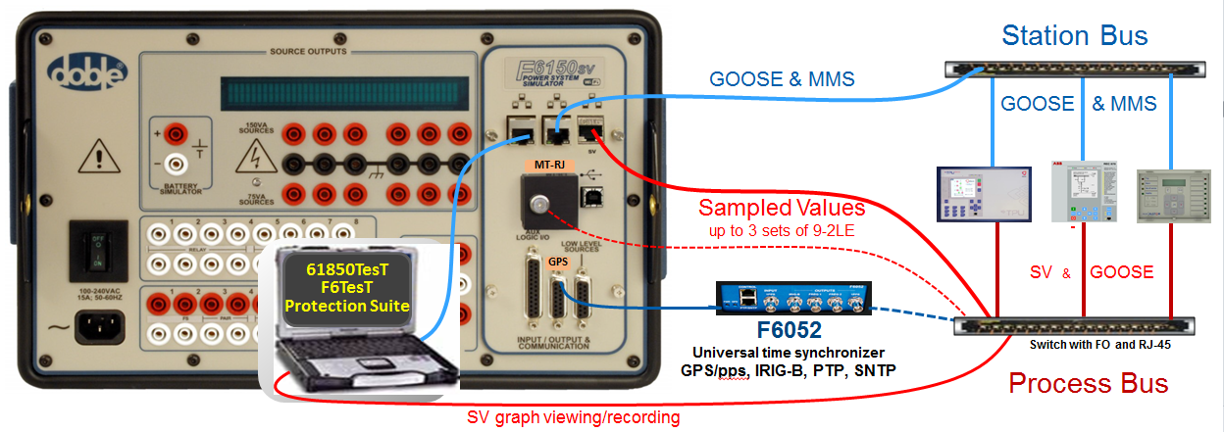
World leader in Power System Protection Testing
Testing tools for IEC 61850-based protection, automation & control systems
F6150sv power system simulator tests IEC 61850-based systems and conventional systems
6 voltage source: 75V, 150V; 300V ph
convertible to currents: 0.5A, 1A, 1.5A,
up to 3A 3ph, or 9A 1ph
Up to 1024 GOOSE signal inputs and outputs
6 current sources: 8.75A, 17.5A, 35A
up to 70A 3ph, or 210 A 1ph
Battery simulator – up to 300 Vdc
8 logic inputs and outputs

Slide 2
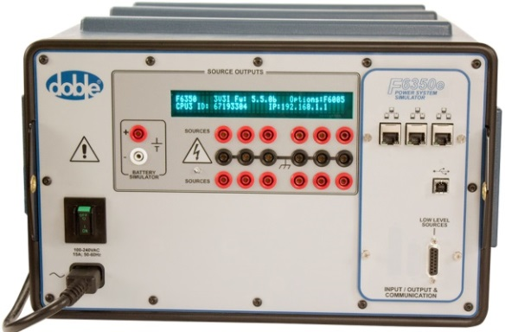
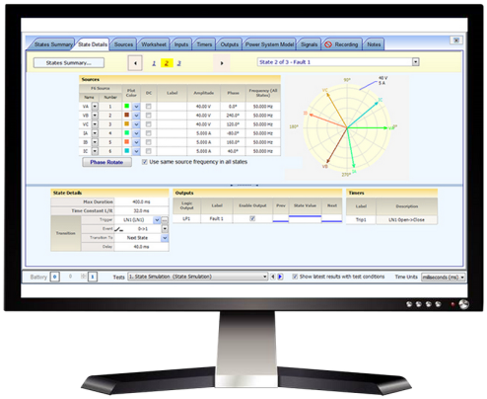
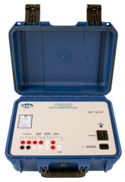

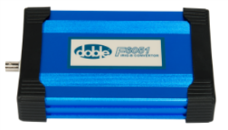
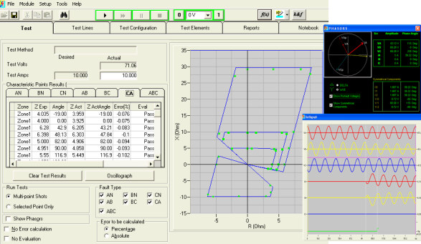
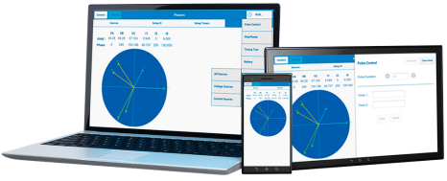
World leader in Power System Protection Testing
Ensure protection system performance through testing, data management and compliance reporting solutions
F6080 Field Calibration Unit
F6052 universal time synchronizer
F6051
IRIG-B to GPS converter
F6300e & F6350e enhanced amplifiers
for high power protection testing. Provides additional current & voltage sources, for critical high burden relay testing and system modeling
Protection Suite software
Complete, no-compromise, protection testing solution. Automated tests for protection-scheme verification
F6TesT advanced visual software
Test complex protection functions like differential, impedance, power swing, and more
F6011 Mobile Control Panel Application

