Slide 2

Outline
Introduction
Testing features defined in IEC 61850
Development of the Simulation Models
A Simple Test Demo
Questions and Answers

Slide 3
Introduction
IEC 61850 has become the preferred standard for substation automation systems (SAS) around the world
Testing and validating of multi-function capable IEDs used in newly deployed integrated and complex smart automation systems can be challenging due to the unavailability of an accurate replica test system
IEDs supporting testing features defined in IEC 61850 Edition 2 can be tested in a virtual environment simulated by a real-time simulator

Slide 4
Testing Features Defined in IEC 61850
Some of the main testing features
The Simulation of GOOSE and SMV telegrams
GOOSE and SMV Supervision (LGOS / LSVS)
Mode and Behaviour of functions
MMS service parameter Test

Slide 5
Data Used for Testing - Simulation
As described in IEC 61850-7-1 Edition2: in order to carry out functional, commissioning or maintenance tests, a communications network-based SAS that supports testing functions should offer some of the following facilities:
  At the IED level, the option of receiving multicast simulation signals instead of actual signals
  At the LN (function) level, the option of receiving test input signals instead of actual signal
  At the LN (function) level, the option of setting a function or a group of functions of the system in test mode

Slide 6
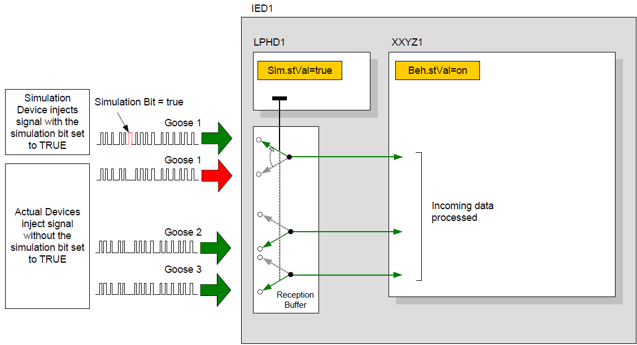
Data Used for Testing - Simulation

Slide 7
GOOSE and SMV Supervision
The LGOS and LSVS logical nodes may be used to monitor subscription states to GOOSE or SMV signals. They contain mandatory information like status of the subscription (active, not active) and other optional information
The subscriber’s root LD LPHD.Sim.StVal is used to switch the ability of the DUT to accept real or simulated test signals, then LGOS or LSVS will indicate the state of the incoming signals

Slide 8
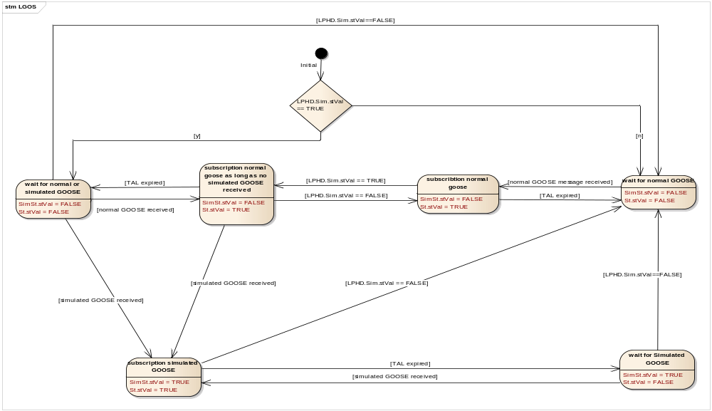
GOOSE and SMV Supervision
IEC 61850 Tissue 1151 -
Data Object | Status | Explanation
LSVS/LGOS.St | TRUE | Message are there and therefore forwarded to the application
 | FALSE | No message received. Application does not get message
LSVS/LGOS.SimSt | TRUE | Subscription switched to simulated telegram only
 | FALSE | Subscription switched to NOT simulated telegram

Slide 9
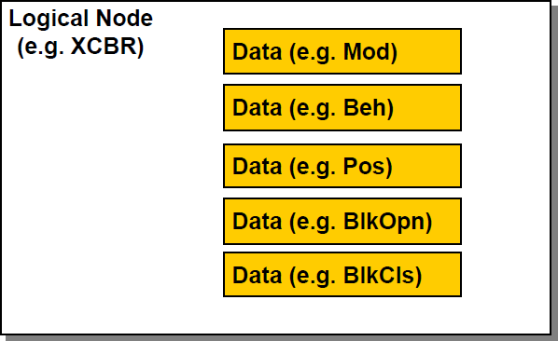
Mode & Behaviour
IEC 61850-7-4 defines a list of logical nodes. Each logical node (e.g. a circuit breaker is abbreviated as “XCBR”) is composed of several data that represent some application-specific meaning
Mod is a controllable data representing the current operation mode of the circuit breaker logical node (on, on-block, test, test/blocked, off).
Beh is a non-controllable data and has the same values as Mod. It represents the combination status of the mode of a logical node and the mode of the containing logical device*
*A logical device is mainly a composition of logical nodes and additional services (e.g. GOOSE, sample value exchange, setting groups). The logical node zero (LLN0) represents common data of the logical device. For example, the mode of LLN0 is used to control the mode of the whole logical device and, as a result, the mode of every logical node being part of the logical device.

Slide 10
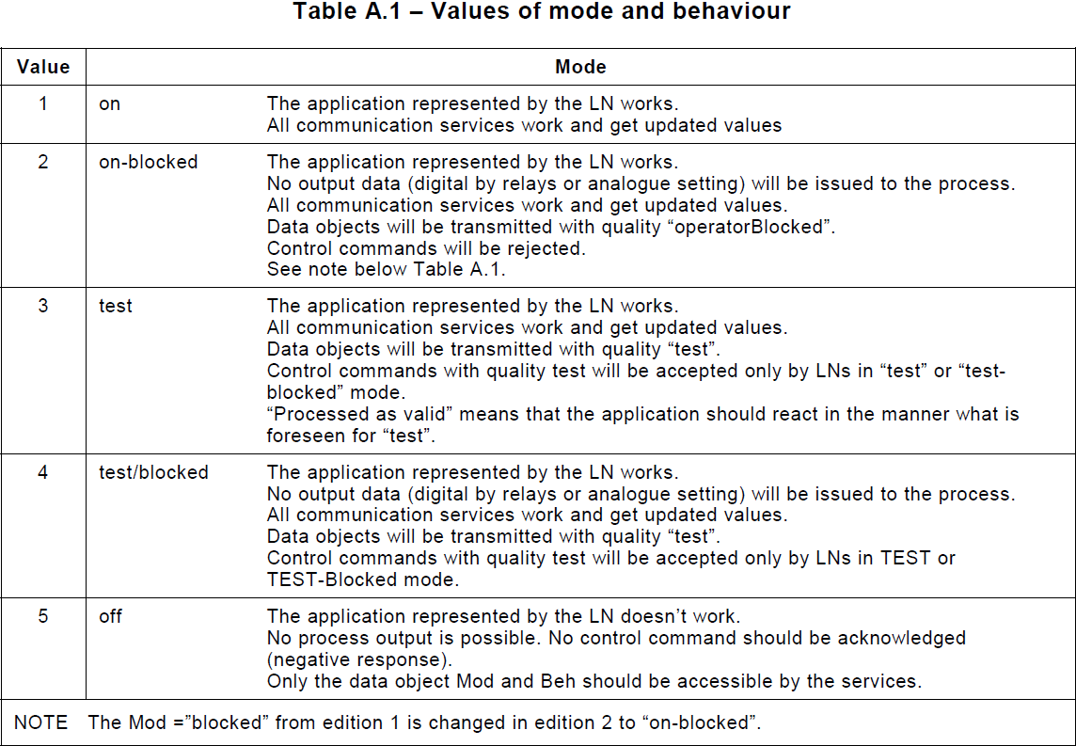
Values of Mode & Behaviour
Switching between the modes (Mod.stVal) should only happen as a result of an operator command to the data object Mod
Mod and Beh are always accessible by the services
The communication services for the data object Mod do not care about the status of the Beh of the LN

Slide 11
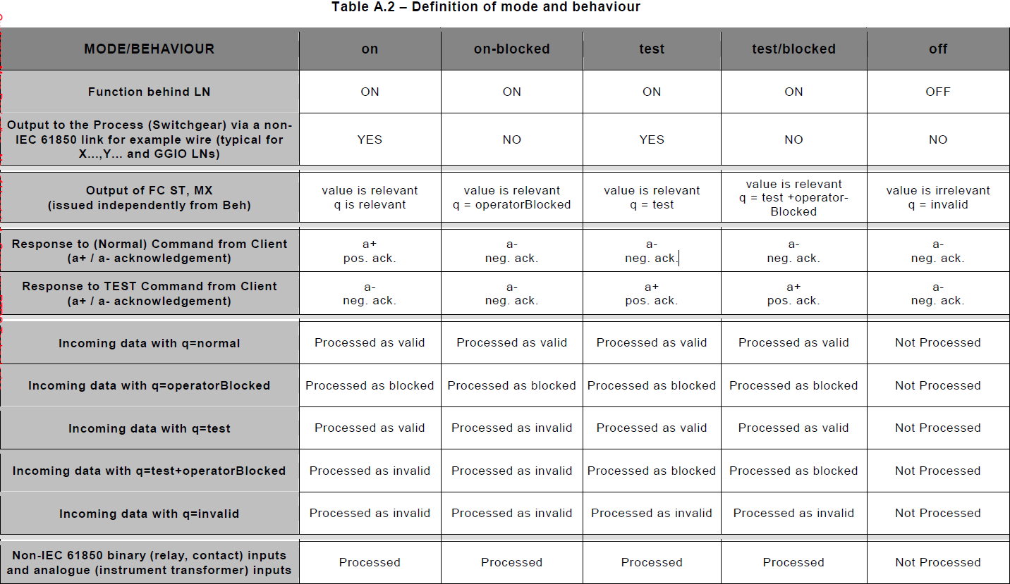
Definition of Mode & Behaviour

Slide 12
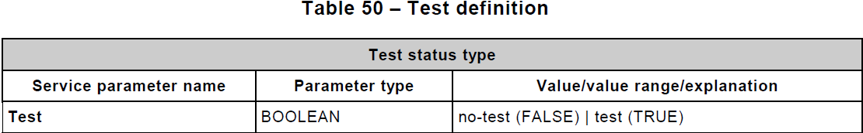
Service Parameter Test
The MMS service parameter Test shall be the test status of the control service
It shall determine if the client sends a control service for the test purpose or not
All service primitives belonging to one control sequence shall carry the same test status

Slide 13
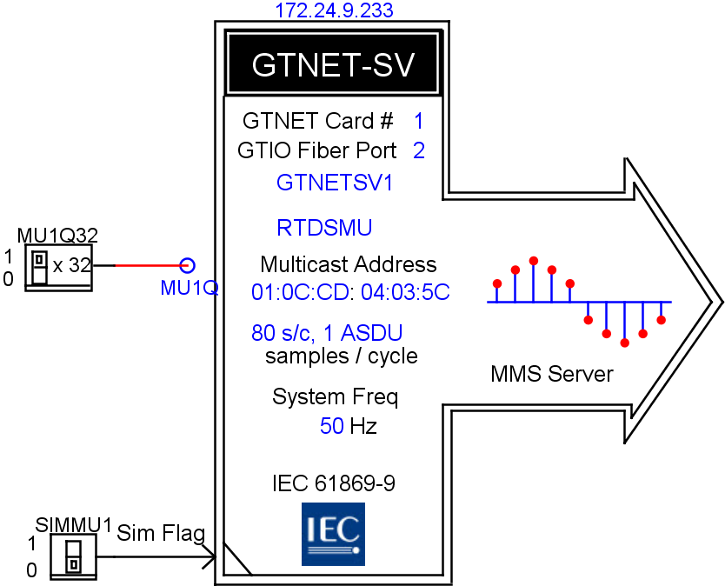
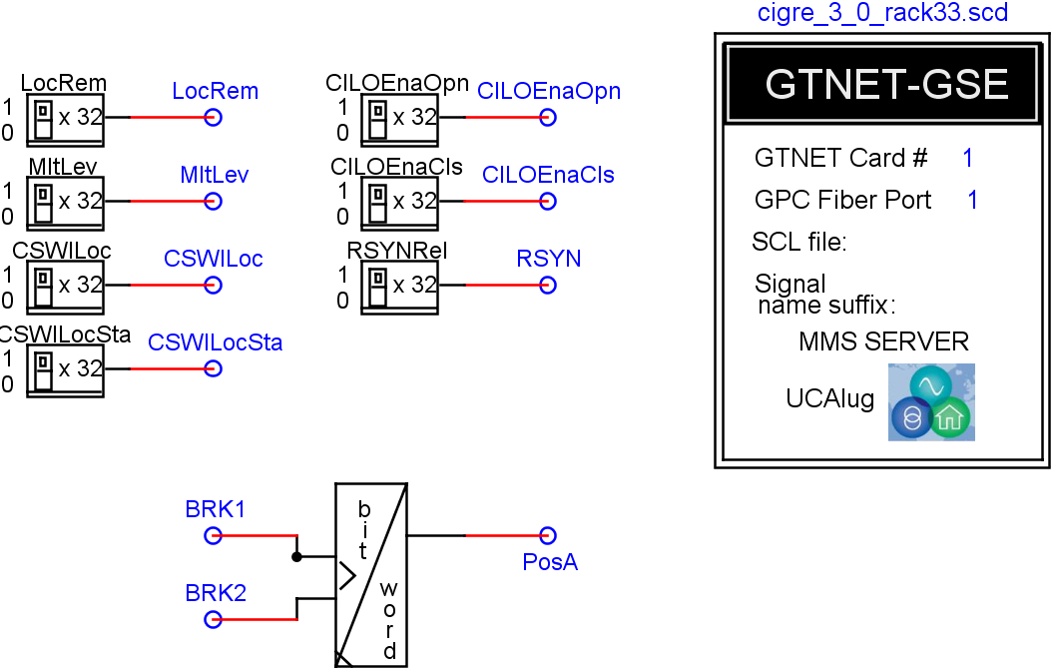
Simulation Models
Simulation models were developed in the Real-Time Digital Simulator to provide testing functions
The information exchange between the virtual environment simulated by the simulator and external physical IEDs under test is through the Network Interface Card (NIC)
Testing functions provided by the simulation models and the NIC –
  Simulation of GOOSE/SMV with configurable Simulation flag
  Subscription of GOOSE/SMV with the support of supervision logical nodes (LGOS/LSVS)
  The NIC serves as a MMS server to provide Client-Server monitoring/control related services

Slide 14
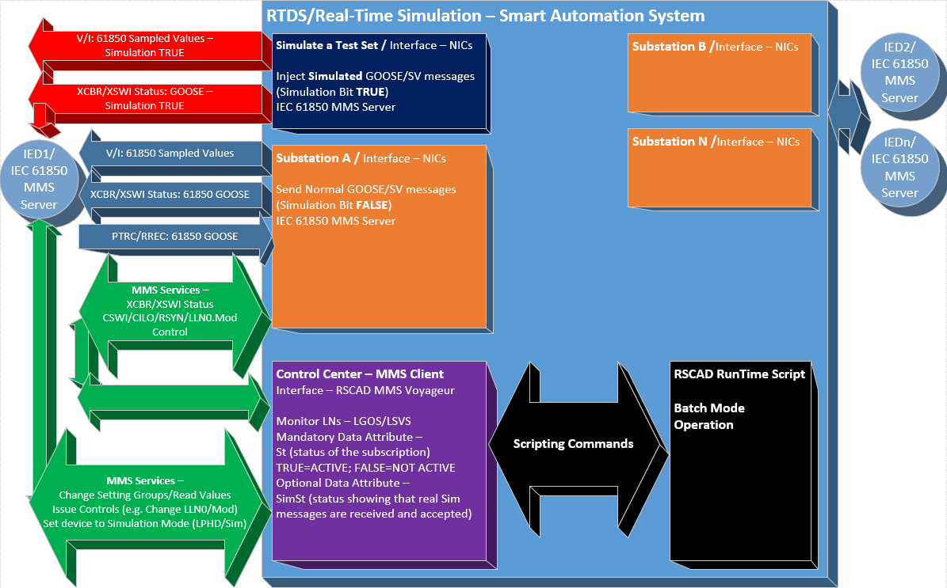
Integrated Testing
The integrated testing can be automated using the Scripting utility available in the simulator

Slide 15
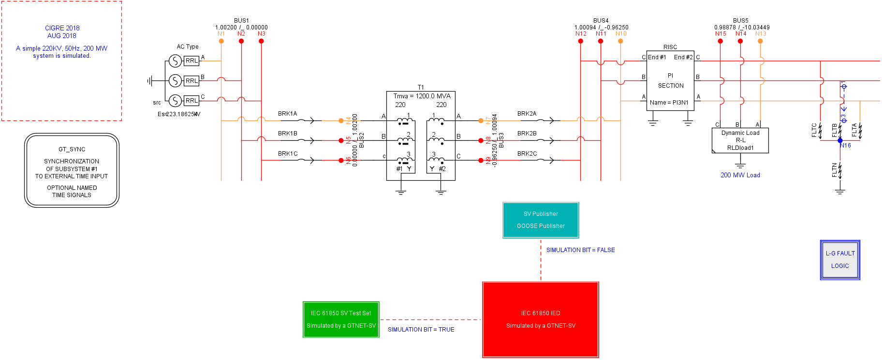
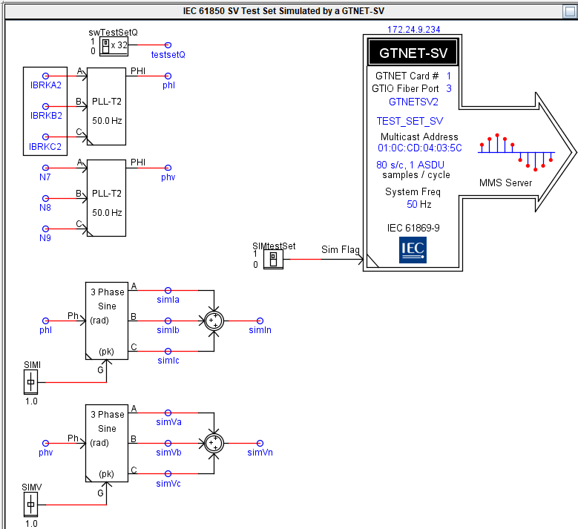
A Simple Test Demo

Slide 16
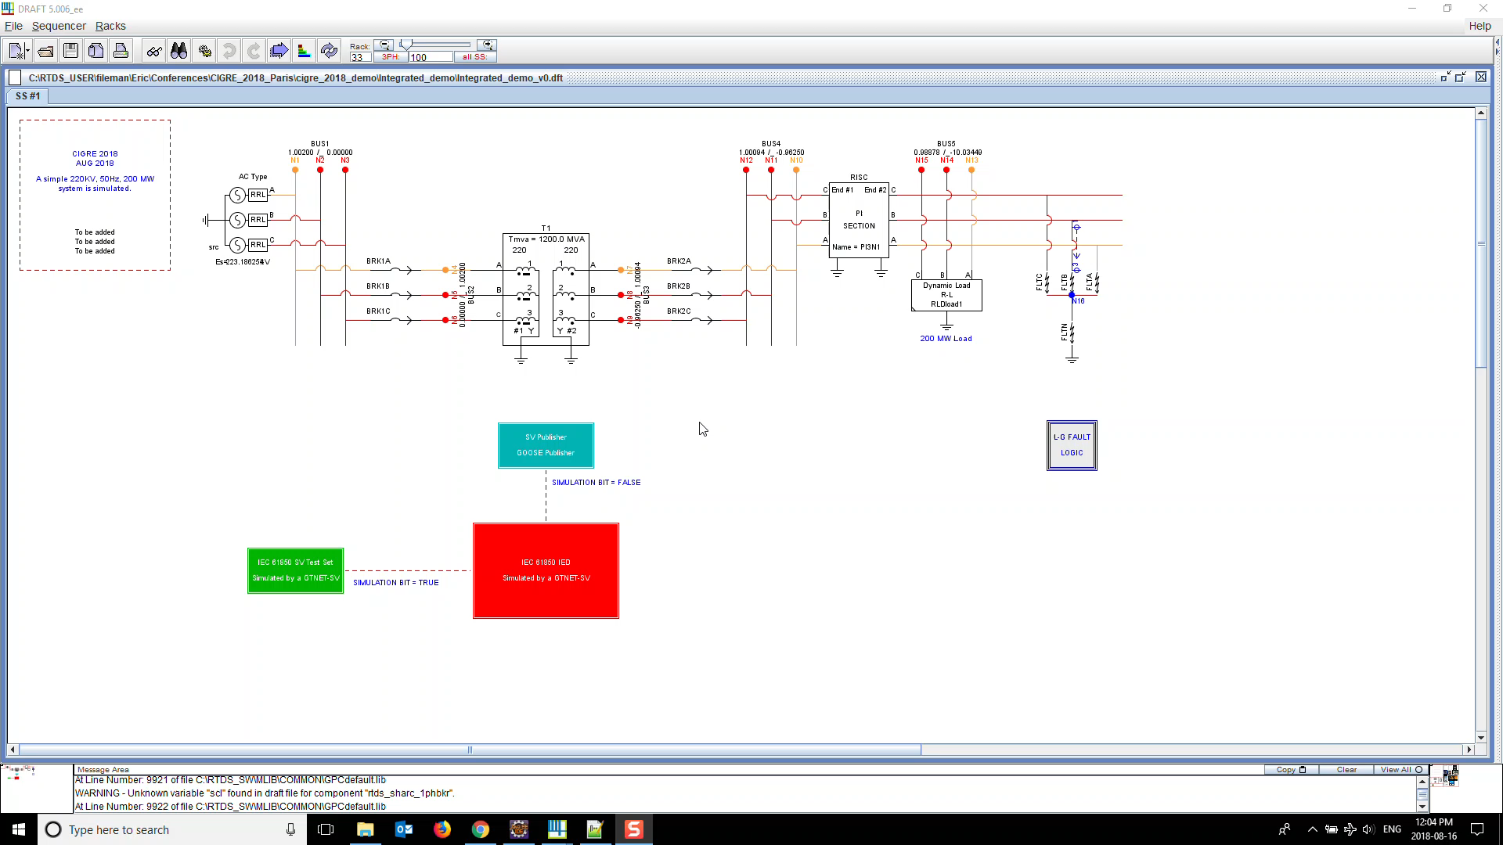
A Simple Test Demo

Slide 17

Questions

