Slide 1


Cigre Paris
27-31 August 2018
Palais de Congrès

Slide 2
Booth logistics
Sunday:
  Building up demo as of 2pm
  Access to the Opening Ceremony on Sunday from 4pm & cocktail afterwards
Monday:
  61850 meeting at 4pm, open for all, snacks and wine
  Show is open until 8pm
  Cocktails open to all in the Exhibition Halls on the 3 levels, from 6 pm to 8 pm
Friday: tear down booth as of 4pm

Slide 3
Security
Security ordered:
Sun 26/08 19.00-8.00
Mon. 27/08 18.30-8.00
Tue. 28/08 18.30-8.00
Wed. 28/08 18.30-8.00
Thu. 29/08 18.30-8.00

Slide 4
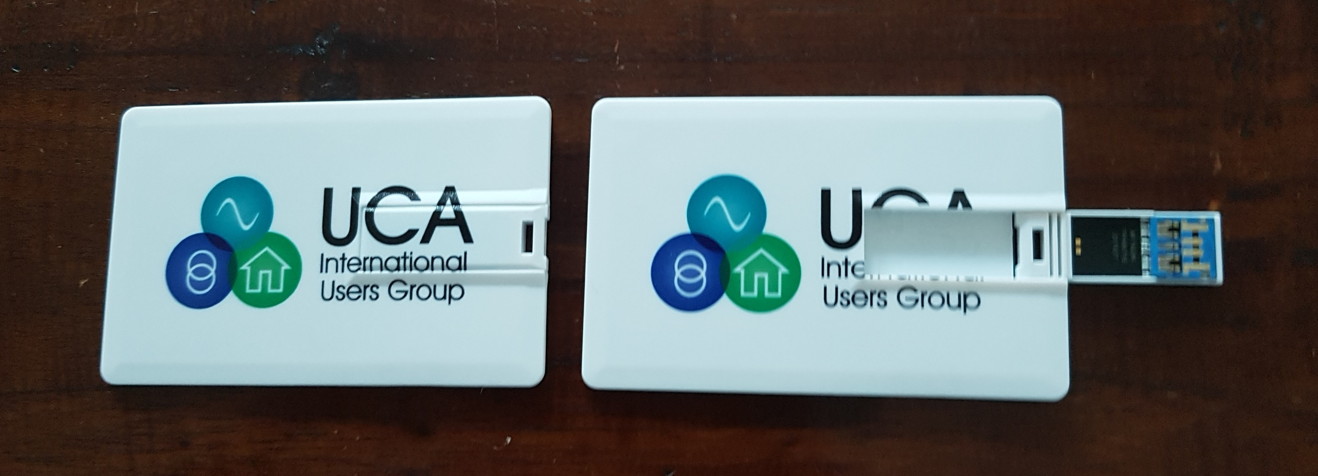
USB stick
USB sticks ordered: 3.0 – 16GB

Slide 5
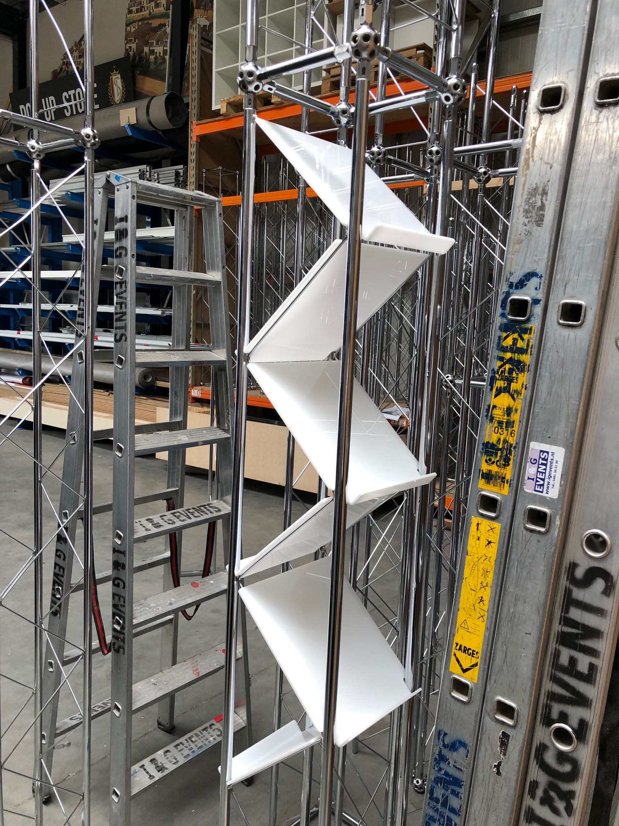
Folder racks
18 in total - 2 pillars:
per pillar 4 on one side,
5 on the other side.

Slide 6
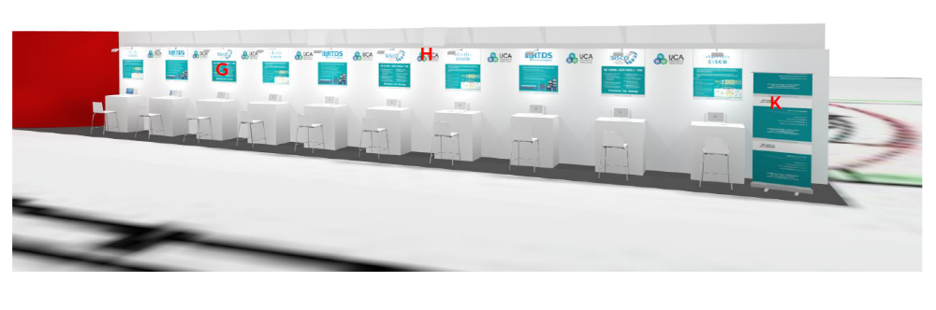
Desk assignment (left to right)
1 Triangle Microworks
2 Schneider Electric
3 Doble
4 SEL (2 desks)
5 RTDS
6 DNV GL
7 SISCO

Slide 7
Actionlist
Upload booth presentations to the site (not 1 yet!)
Running presentations-missing: KERI, Opal-RT, SISCO, Schneider. SEL and RTDS old files?
UCAIug Cigre Pressrelease > Press center:
  Pressrelease approved?
Prepare announcement 61850 booth meeting:
  Press center and mailing delegate list

Slide 8
Any other business
Shipping your collateral: http://www.cigre-exhibition.com/wp-content/uploads/sites/1/Transport-Customs-Handling2.pdf
Booth hand-over: Sun. 26th August, 2pm
Dismantling booth: Fri. 31st August, 4pm

