Slide 1





Enabling Interoperability for the Utility Enterprise
And TESTING

Slide 2



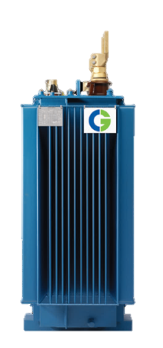
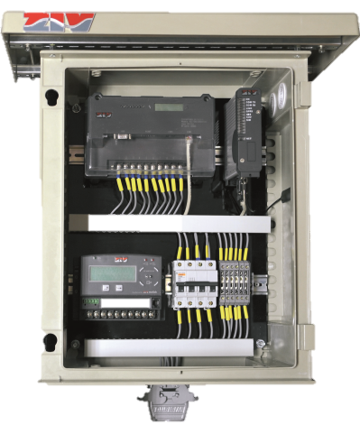
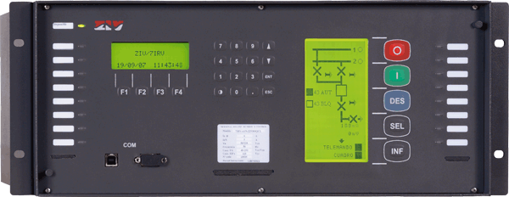
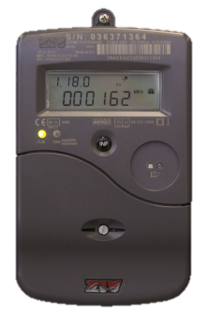
Visit us at booth 354
Power Transformers. Switchgears. Motors
Protection Relays & Communication Products. IEC 61850 Substation Automation Systems
Smart Meters
& Distribution Automation Solutions

Slide 3
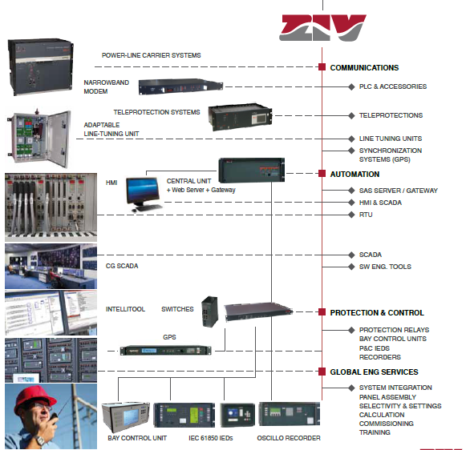
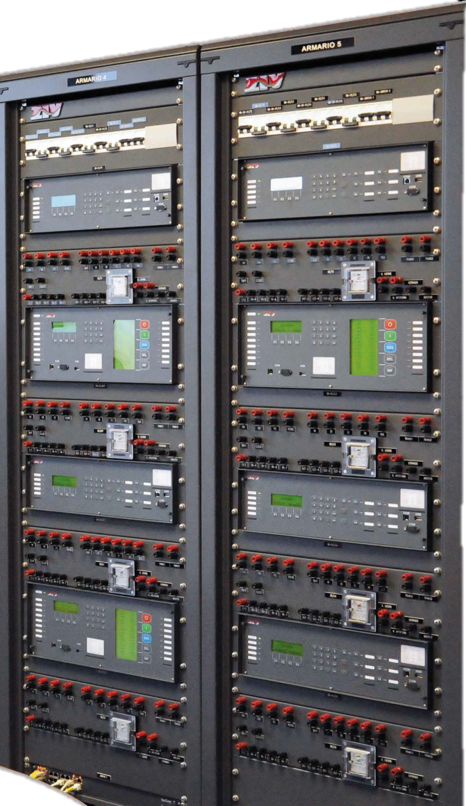
Complete IEC 61850
ZIV Substation Automation Systems
Visit us at booth 354

